Slide 1
Case study
August 2018
Customer churn prediction and analysis

Slide 2
Outline
Objectives
Data source
Methodology
Results
Summary

Slide 3
Objectives
Determine factors that contribute towards churn
Predict churn probability
Identify initiatives that could reduce churn

Slide 4
Data source
Customer records
7043 rows
21 features
Primary feature – Churn (yes/no)

Slide 5
Methodology
Prepare data
Remove rows with invalid features
Build candidate models
Logistic regression
Select best performing model
Evaluate each model
Remove redundant features
Bin continuous features
“One-hot” encode categorical features
Extreme gradient boosting
Multilayer perceptron (Artificial neural network)
Random forest
Select model that returns the fewest false positives
Analyse variables
Use variable importance to suggest initiatives that can reduce churn

Slide 6
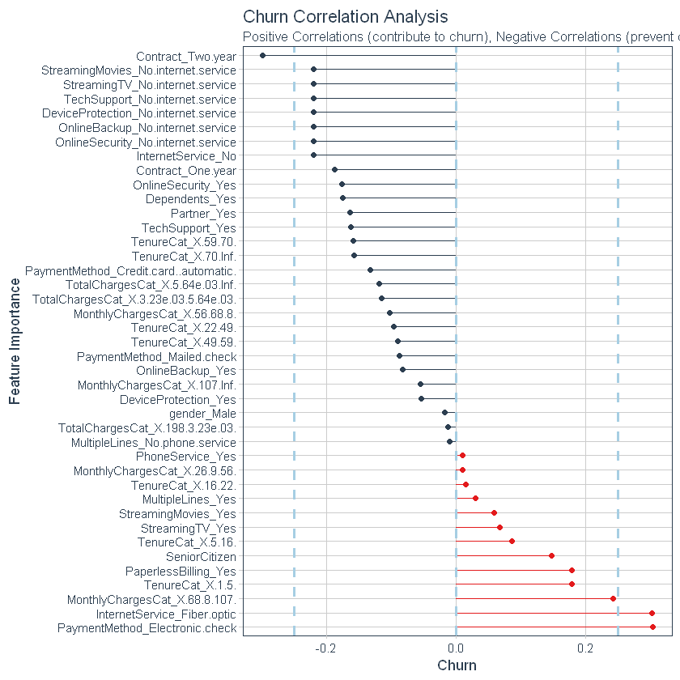
Results
This chart indicates how the different variables contribute towards customer behaviour.
Variables with the most extreme values should be considered for initiatives to reduce churn.
Variables with positive values should be incentivised while those with negative values should be investigated to find possible reasons why they lead to a higher likelihood to churn.

Slide 7
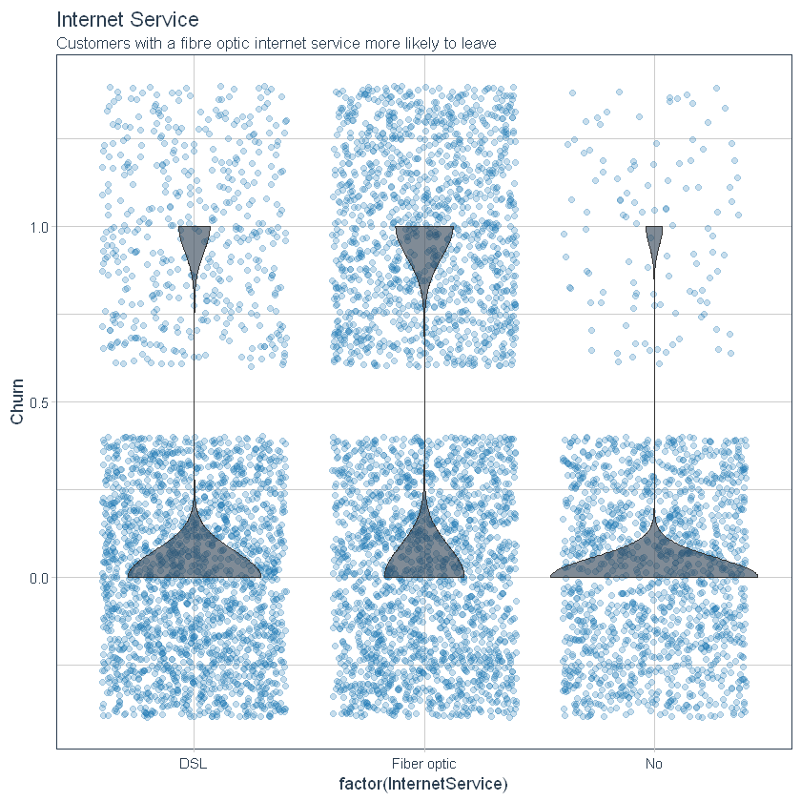
Results

Slide 8
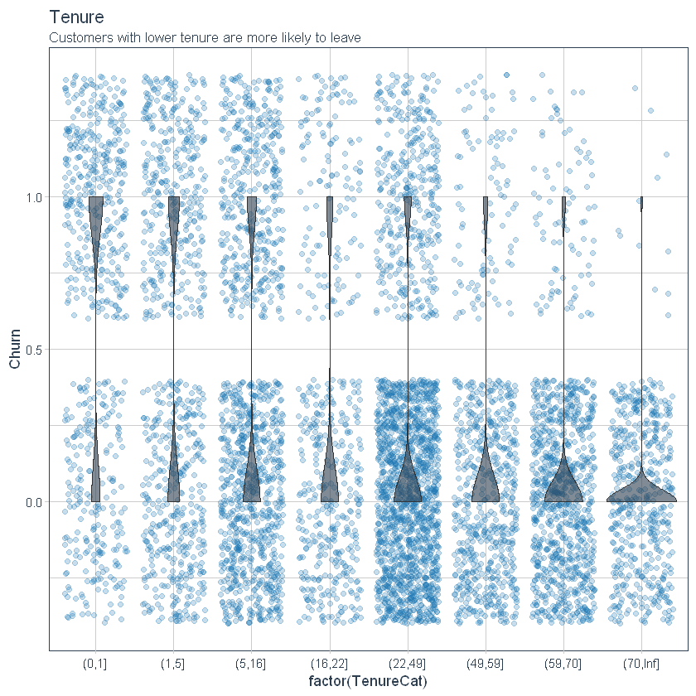
Results

Slide 9
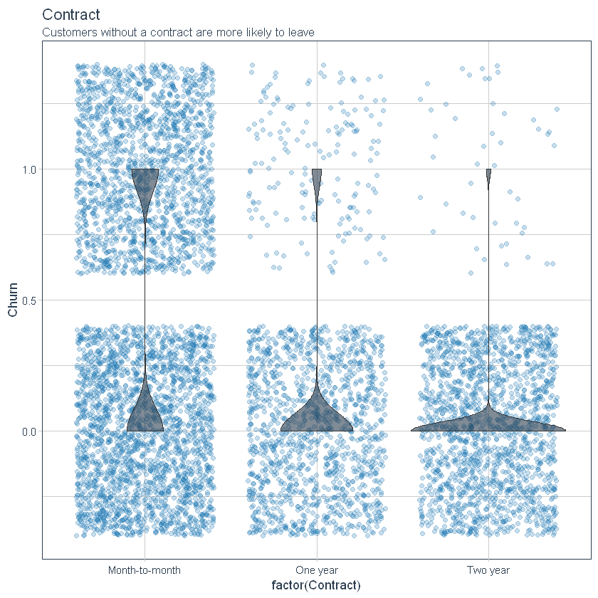
Results

Slide 10
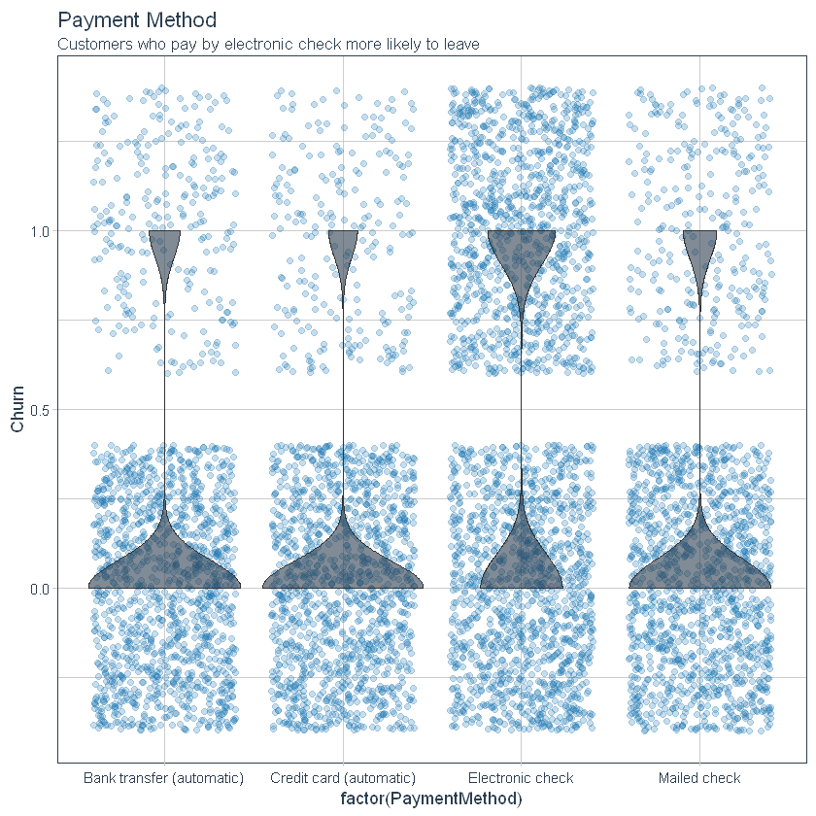
Results

Slide 11
Results
Incentives to reduce churn
Offer promotional 2-year contracts to customers with tenure less than 12 months.
Investigate why customers with fibre optic internet are leaving.
Promote and incentivise automated payment methods

Slide 12
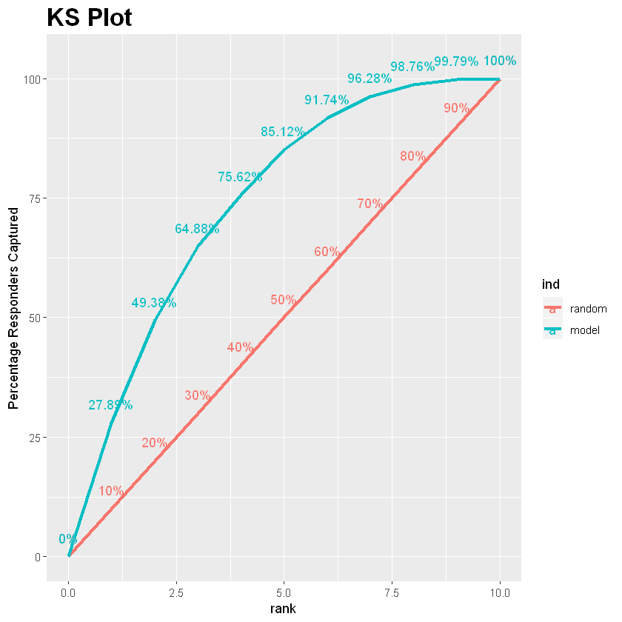
Summary
This plot indicates how much better the model performs than randomly guessing.
Predictions were made using an MLP model trained on 80% of the data.
 | Actual
Predicted | No | Yes
No | 1146 | 231
Yes | 128 | 253

